Slide 1




LARGE EDDY SIMULATION OF IMPACT OF NUMBER AND TYPE OF VEHICLES ON FIRE DYNAMICS IN TUNNEL
Darko Zigar, Faculty of Occupational Safety in Niš
Dušica Pešić, Faculty of Occupational Safety in Niš
Milan Blagojević, Faculty of Occupational Safety in Niš

Slide 2
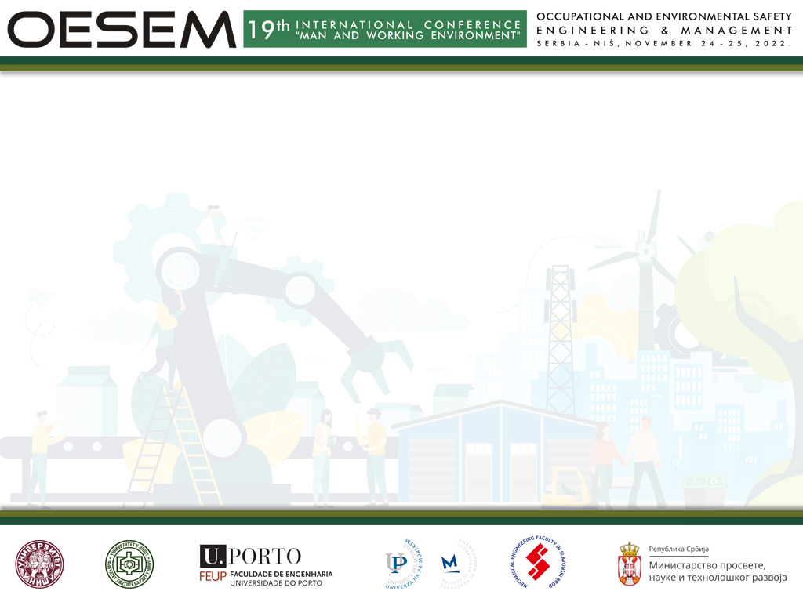
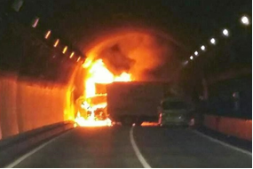
INTRODUCTION
Fire safety in road and rail tunnels is very important due to the possibility of tunnel fire incidents involving passengers and cargo vehicles. Also, it is necessary to understand the growth and spread of fire in the tunnel in order to assess the conditions for evacuation of vulnerable people and firefighting.
Figure 1. Tunnel fire

Slide 3
The rate of evacuation and the response time of fire rescue units directly depend on fire dynamics. In this paper, numerical simulations of several characteristic fires in the tunnel under various occupancy conditions with different types of vehicles were performed due to the aforementioned reasons.
In contrast to buildings, which have a relatively constant fire load and where the risk of fire can be assessed, the scenario in tunnels is quite different. The fire load in the tunnel is variable and almost unpredictable.

Slide 4
Even a small-scale fire can have serious consequences. The main threat is posed by pyrolysis and combustion products, specifically the resulting smoke, which can cause death in such a small space, even in small amounts.
Because the problem in fire protection is primarily based on controlling the spread of smoke, it is important to assess how the number and type of motor vehicles affect the dynamics of the fire.
By analyzing the results of the numerical simulation, adequate answers can be given about the behavior, i.e. fire dynamics in the tunnel, and considering the effectiveness of the fire protection system in them, as well as the possibility of evacuation from the tunnel can be provided.

Slide 5
MATERIALS AND METHODS
Numerical model
For fire simulation, a 3D concrete tunnel model with dimensions 300 x 11.7 x 7.1m was created in the Thunderheadeng Engenering Pyrosim software, Figure 2.
A uniform numerical grid with grid cell dimensions of 0.4 x 0.4 x 0.4m, i.e. 391500 grid cells was used for calculation.
A fire of spilled octane fuel in the center of the tunnel was simulated with a heat release amount of 5000kW/m², and spilled fuel dimensions of 4 x 5m, i.e. an area of 20m², giving a total released amount of heat of 100MW (NFPA 502), Figure 3.
In the first three simulations, the number of passenger vehicles changed from 72 (100% tunnel occupancy), to 36 (50% tunnel occupancy), and then to 18 (33% tunnel occupancy).

Slide 6
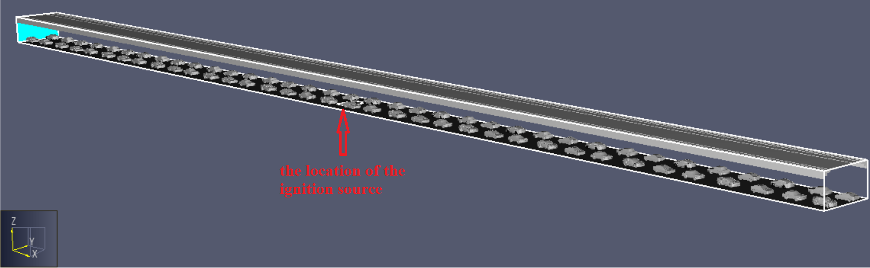
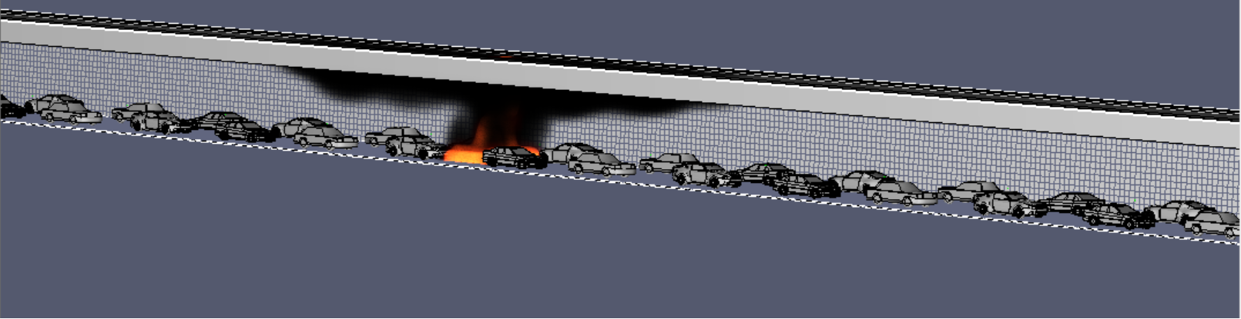
Figure 2. The layout of the 3D tunnel model used for simulation
Figure 3. The layout of the numerical grid for calculation and ignition source

Slide 7
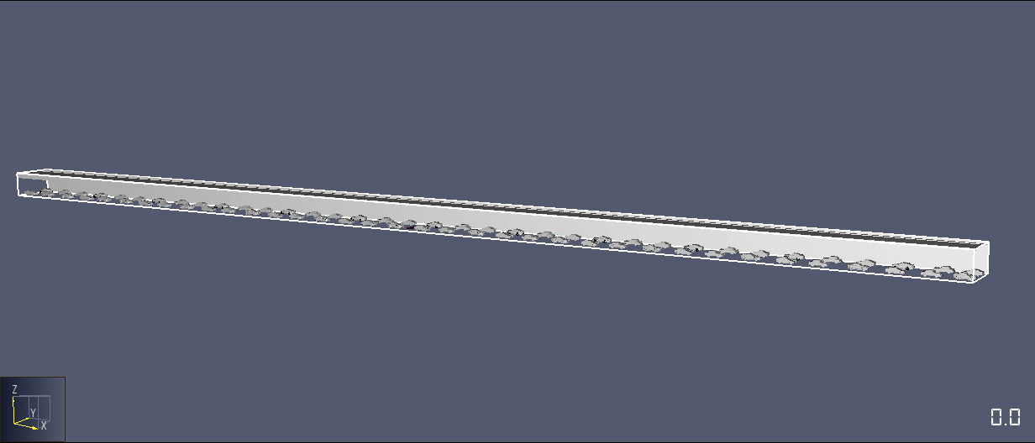
RESULTS OF A FIRE SIMULATION IN A TUNNEL WITH 100% OCCUPANCY BY PASSENGER VEHICLES
Fire and smoke development in a tunnel

Slide 8
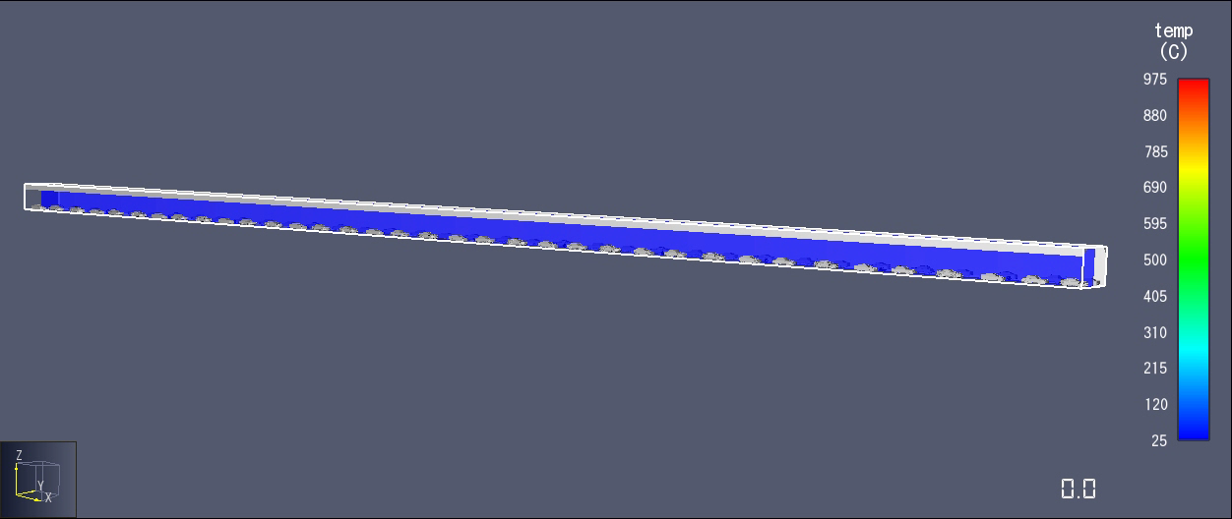
RESULTS OF A FIRE SIMULATION IN A TUNNEL WITH 100% OCCUPANCY BY PASSENGER VEHICLES
Temperature

Slide 9
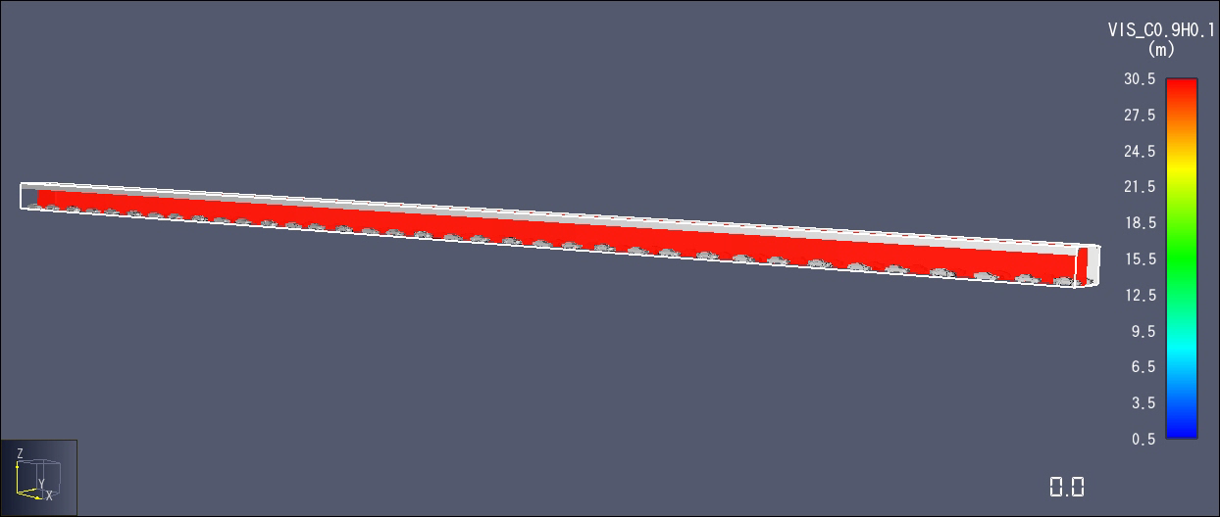
RESULTS OF A FIRE SIMULATION IN A TUNNEL WITH 100% OCCUPANCY BY PASSENGER VEHICLES
Smoke visibility

Slide 10
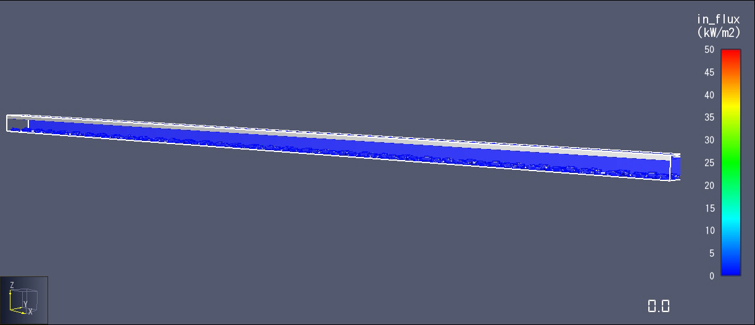
RESULTS OF A FIRE SIMULATION IN A TUNNEL WITH 100% OCCUPANCY BY PASSENGER VEHICLES
Incident heat flux

Slide 11
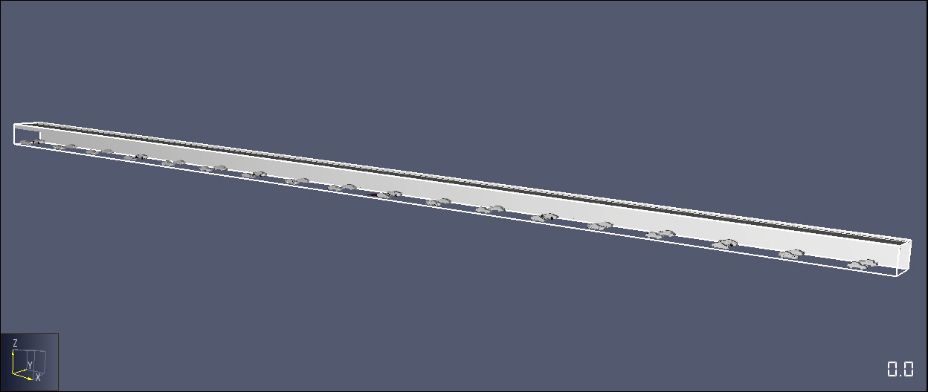
RESULTS OF A FIRE SIMULATION IN A TUNNEL WITH 50% OCCUPANCY BY PASSENGER VEHICLES
Fire and smoke development in a tunnel

Slide 12
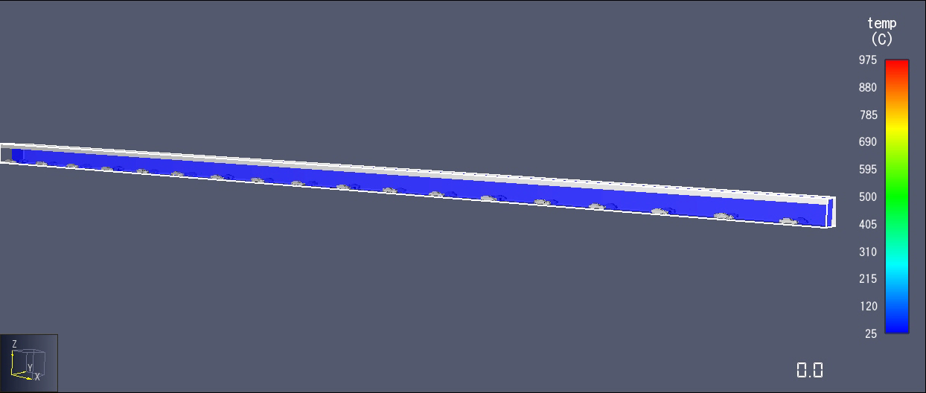
RESULTS OF A FIRE SIMULATION IN A TUNNEL WITH 50% OCCUPANCY BY PASSENGER VEHICLES
Temperature

Slide 13
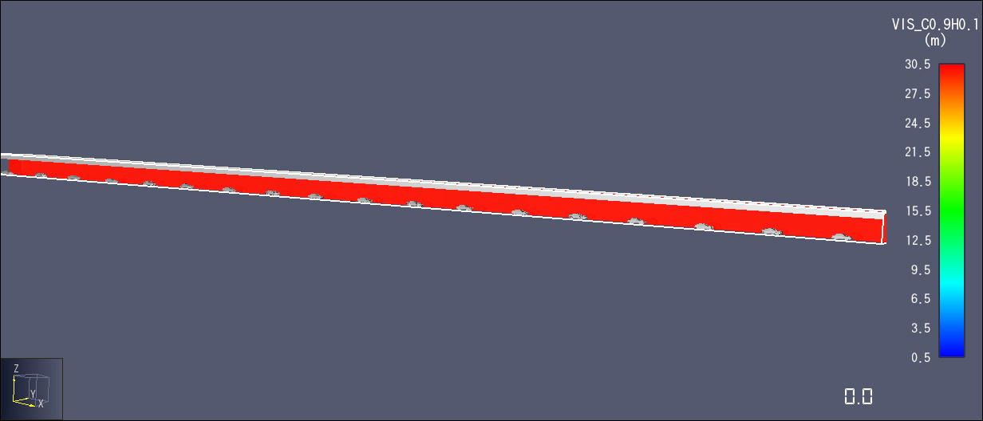
RESULTS OF A FIRE SIMULATION IN A TUNNEL WITH 50% OCCUPANCY BY PASSENGER VEHICLES
Smoke visibility

Slide 14

RESULTS OF A FIRE SIMULATION IN A TUNNEL WITH 50% OCCUPANCY BY PASSENGER VEHICLES
Incident heat flux

Slide 15
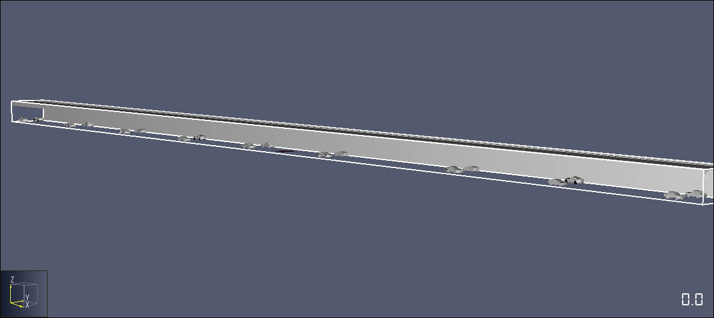
RESULTS OF A FIRE SIMULATION IN A TUNNEL WITH 33% OCCUPANCY BY PASSENGER VEHICLES
Fire and smoke development in a tunnel

Slide 16
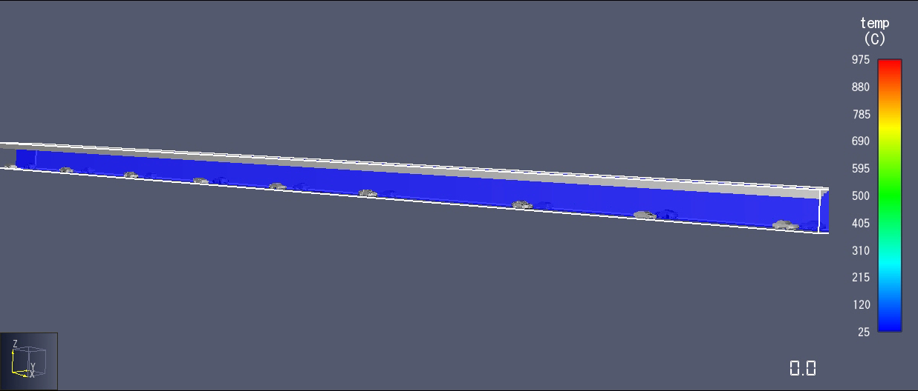
RESULTS OF A FIRE SIMULATION IN A TUNNEL WITH 33% OCCUPANCY BY PASSENGER VEHICLES
Temperature

Slide 17
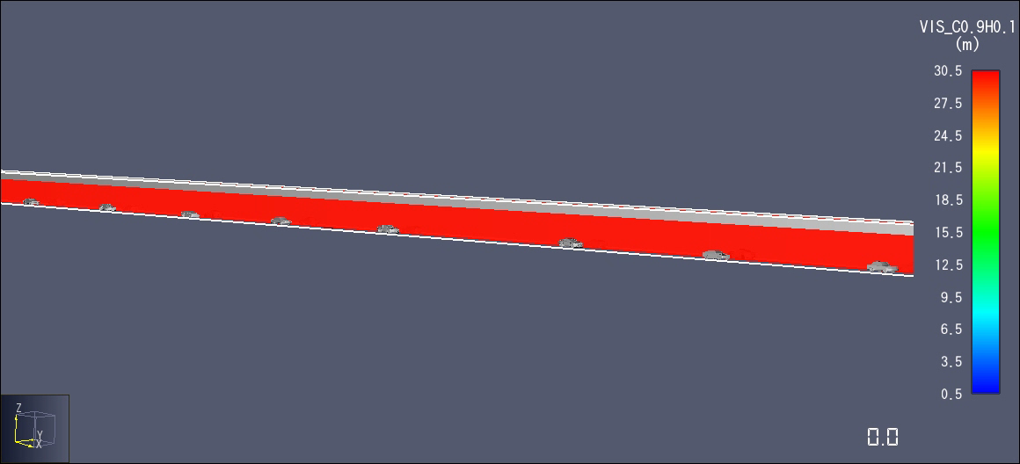
RESULTS OF A FIRE SIMULATION IN A TUNNEL WITH 33% OCCUPANCY BY PASSENGER VEHICLES
Smoke visibility

Slide 18
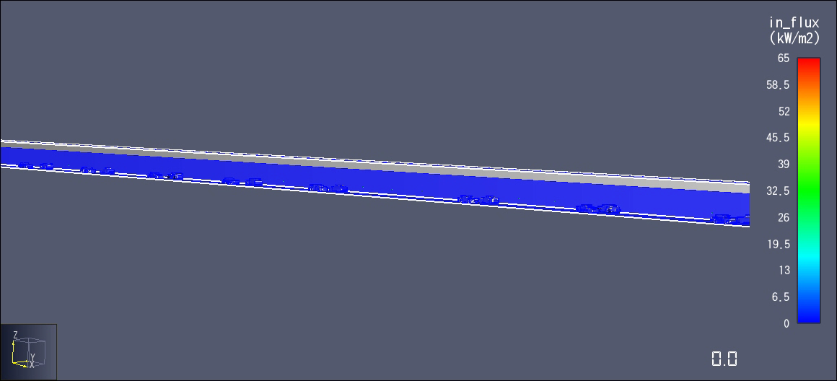
RESULTS OF A FIRE SIMULATION IN A TUNNEL WITH 33% OCCUPANCY BY PASSENGER VEHICLES
Incident heat flux

Slide 19
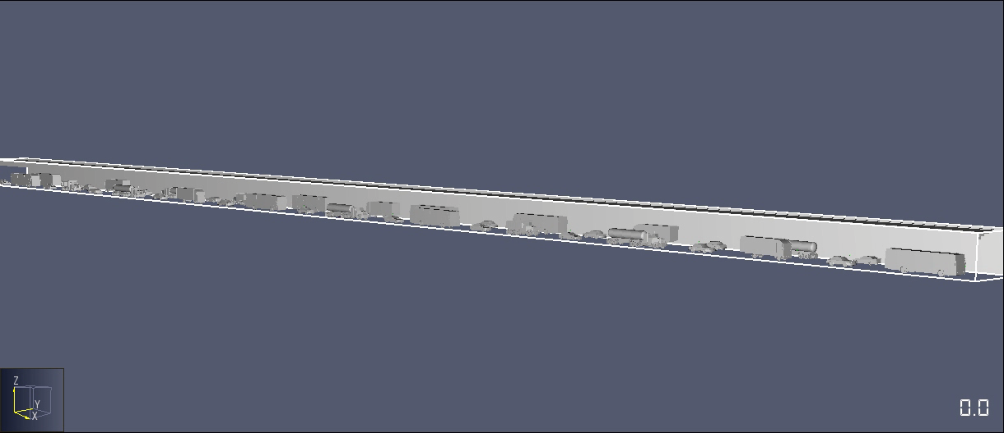
RESULTS OF A FIRE SIMULATION IN A TUNNEL FILLED WITH PASSENGER AND CARGO VEHICLES
Fire and smoke development in a tunnel

Slide 20
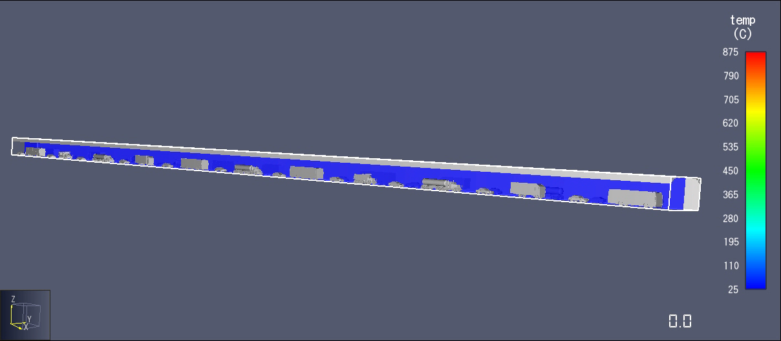
RESULTS OF A FIRE SIMULATION IN A TUNNEL FILLED WITH PASSENGER AND CARGO VEHICLES
Temperature

Slide 21
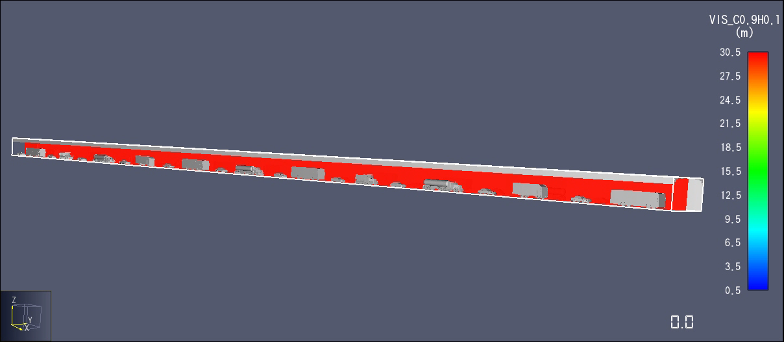
RESULTS OF A FIRE SIMULATION IN A TUNNEL FILLED WITH PASSENGER AND CARGO VEHICLES
Smoke visibility

Slide 22
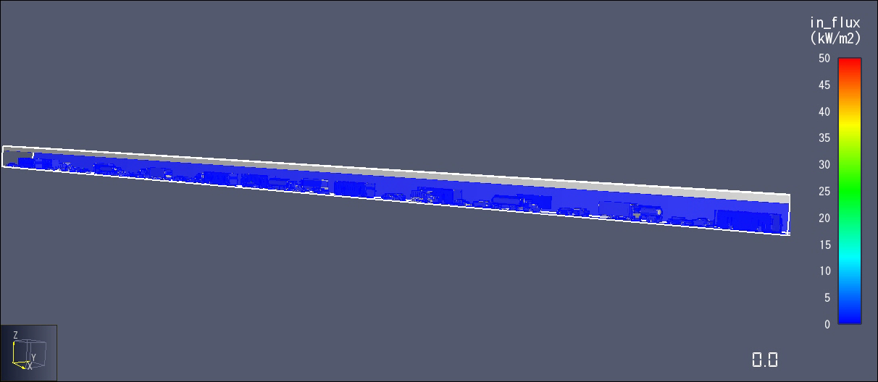
RESULTS OF A FIRE SIMULATION IN A TUNNEL FILLED WITH PASSENGER AND CARGO VEHICLES
Incident heat flux

Slide 23
ANALYSIS OF SIMULATION RESULTS
Fire development and smoke spread. The fastest smoke filling of the tunnel was recorded when tunnel was completely occupied by passenger vehicles and when there were also freight vehicles present. The reason for this is that the volume of space filled by combustion products is reduced. The faster the tunnel fills with smoke, the fewer vehicles there are in it. The area close to the tunnel's ceiling is fumigated the quickest, and over time the layer of smoke descends.
Temperature in the tunnel. The highest temperatures are recorded in the simulation when there are the most vehicles in the tunnel space.The reason for this is not only the reduction of the space that is heated, but also the radiation of heat that accumulates over time on the steel sheet of the vehicle. This contributes to the further radiation of that accumulated heat, resulting in an increase in the temperature in the tunnel. Also, a larger number of vehicles in the tunnel prevents and slows down the inflow of colder fresh air from the ends of the tunnel, necessary for the combustion process, so there is less cooling inside the tunnel.

Slide 24
ANALYSIS OF SIMULATION RESULTS
Smoke visibility. The worst smoke visibility is recorded for the case with the smallest number of vehicles in the tunnel, while visibility increases as the number of vehicles in the tunnel increases. The reason for this is that, due to the reduced space in the tunnel, the speed of the combustion products near the ceiling increases, and thus a larger amount of combustion products is released. On the other hand, the speed of the inflow of fresh air into the tunnel in the ground part increases, which contributes to better visibility at head height man. This can be crucial for evacuation from a tunnel affected by the fire. Unfortunately, in the case when we have a large number of freight vehicles in the tunnel due to their great height and volume, the entire volume of the tunnel quickly becomes smoky.
Incident heat flux. The lowest value of incident heat flux was recorded in the case with the largest number of passenger vehicles and the presence of freight vehicles in the tunnel, because a large part of the heat released during the fire is used to heat the metal surfaces of the vehicles. This situation will likely change if the fire burns longer than expected because those surfaces would produce more heat. In contrast, the highest value of the incident heat flux was recorded for the case with the lowest number of vehicles.

Slide 25
CONCLUSION
Based on all this, it is possible to conclude that having a large number of motor vehicles in one tunnel has a negative impact on the rapid evacuation of people and the intervention of the fire-rescue unit.
As previously stated, this is supported by the appearance of faster smoke due to the faster flow of combustion products, as well as theaccelerated increase in temperature in the tunnel.

Slide 26

Acknowledgement
This paper presents the results of research supported by the Ministry of Education, Science and Technological Development of the Republic of Serbia.

